Slide 1

REDISTRIBUTING ROUTING PROTOCOLS
Final Evaluation
Presenter
Rishi Mehra (2020a1r175)
DEPARTMENT OF COMPUTER SCIENCE AND ENGINEERING
MIET(Autonomous), JAMMU

Slide 2
CONTENTS:-
My Learnings
Introduction
Problem Statement
Solution
Topics used in Project
Technology Used
Command Used
Demonstration

Slide 3
MY LEARNINGS:-
Computer Network
LAN
MAN
WAN
PAN
Transmission Modes
Simplex
Duplex
Half Duplex
Full Duplex
MAC Address

Slide 4
OSI models/layers
Physical Layer
Data Link Layer
Network Layer
Transport Layer
Session Layer
Presentation Layer
Application Layer
IP Address (Internet protocol address)
IP classes (IPv4)
Class A (1-126)
Class B (128-191)
Class C (192-223)
Class D (224-239)
Class E (240-255)

Slide 5
Protocols
Networking Devices
LAN Card
Repeater
HUB
Switch
Bridge
Gateway
Firewall
Router
Cables
Coaxial Cable
Twisted Pair Cable
Straight through cable
Cross over cable
Roll over cable
Optic Fibre Cable

Slide 6
Topology
Bus topology
Ring topology
Star topology
Mesh topology
Tree topology
Hybrid topology
Routing Protocols
RIP (Routing information protocol)
OSPF (Open Shortest Path Protocol)
EIGRP (Enhance Interior Gateway Routing Protocol)
Email Server
WIFI (Wireless Fidelity)

Slide 7
VoIP (Voice Over Internet Protocol)
NAT (Network Address Translation)
VPN (Virtual Private Network)
Redistribution

Slide 8
Use
INTRODUCTION:-
What is Redistribution?
Route Redistribution is the transfer of routes learned from one routing protocol to another.
Used on routers with multiple routing protocols.
Redistribution is used to allow different networks belonging to the same company to communicate with each other.
Redistribution is used when two companies merge and their networks use different routing protocols.

Slide 9
Example
Assume that RIP being used in a growing network. Beyond a hop count of 15, it will become impossible to use RIP.
In this situation, we will need to switch to another routing protocol.
While switching, two protocols would need to co-exist in the network while maintaining complete reachability.
Redistribution of routes from RIP to the new protocol and vice versa can achieve this.

Slide 10
Problem Statement and their Solution
Often, using a single routing protocol in an Organization is preferred but there are some conditions in which we have to use multi protocol routing. These conditions include multiple administrator running multiple protocols, company mergers or usage of multi-vendors devices.
Therefore, we have to advertise a route learned through a routing protocol or by any other means (like static route or directly connected route) in different routing protocol. This process is called redistribution.

Slide 11
Technologies Used
CISCO Packet Tracer
A Network simulation tool where you practice networking, IoT and cybersecurity skills in a virtual lab with no need of hardware.

Slide 12
Topics used in Project
LAN
WAN
IP Address
IP Classes
Networking Devices
Protocols
Cables
Topology
Routing Protocol
Redistribution

Slide 13
Command used
# router rip # redistribute ospf process Id metric 1 # redistribute eigrp process Id metric 1 # router ospf process id # redistribute rip subnets # redistribute eigrp process id subnets # router eigrp process id # redistribute rip metric 1 100 100 100 100 # redistribute ospf process id metric 1 100 100 100 100

Slide 14
DEMONSTRATION

Slide 15
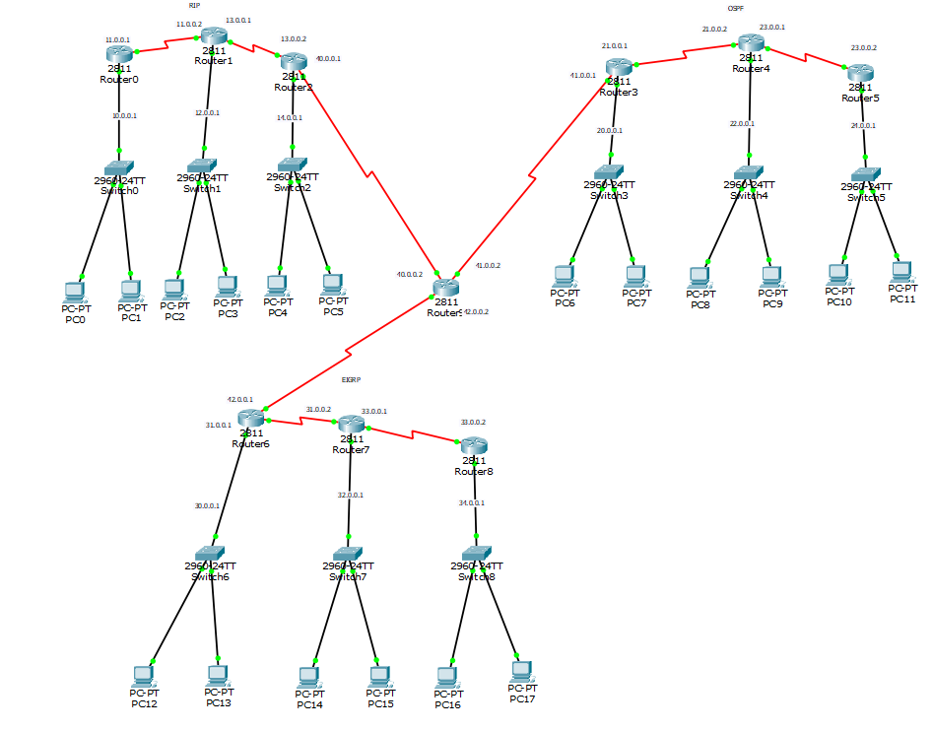
Basic interface

Slide 16


